Slide 1
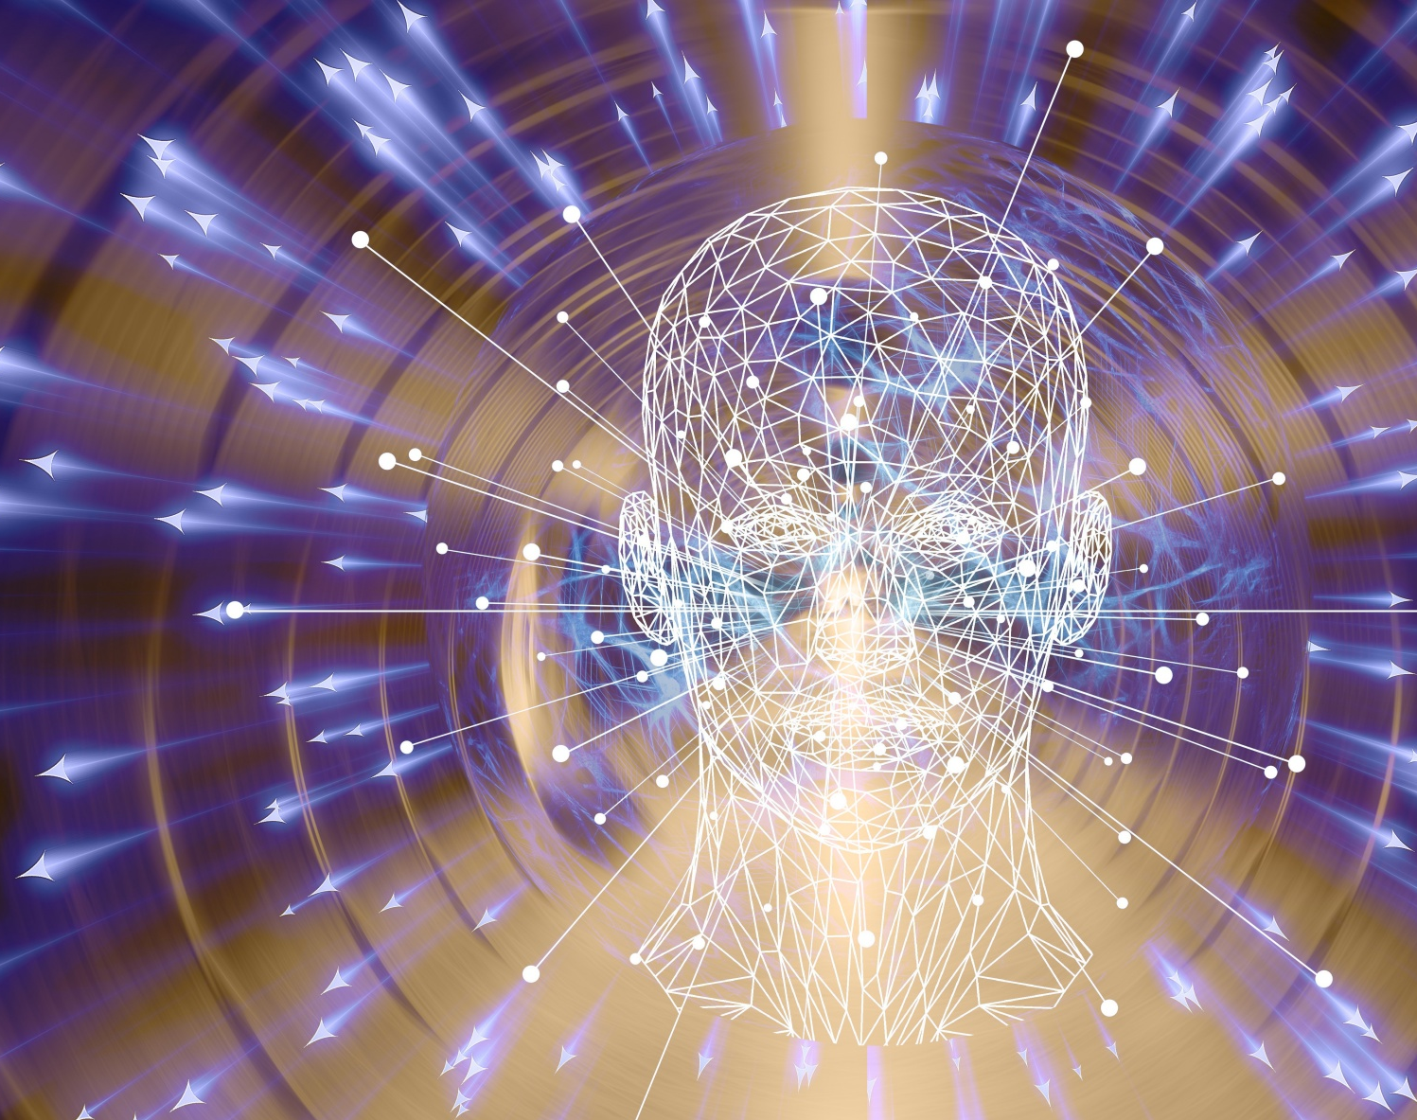
K-Nearest Neighbours PROJECT
VISHAL AGARWAL - 49
ANURAG KASAT- 58
JOY PODDER -59

Slide 2
Introduction:-
KNN classification, also known as k-nearest neighbors classification, is a supervised machine learning algorithm that is used for classification tasks. It works by finding the k nearest neighbors to a given data point and classifying the data point based on the classes of its neighbors.
In other words, given a new data point, KNN classification looks for the k nearest data points in the training set and determines the most frequent class among those neighbors. The new data point is then assigned to that class.
The choice of the value of k is an important parameter in KNN classification. A smaller value of k means that the classification decision is more sensitive to local variations in the data, while a larger value of k can result in a smoother decision boundary but may ignore some fine details in the data.
KNN classification can be used for both binary and multi-class classification problems and is considered a non-parametric method because it does not assume a specific form of the underlying data distribution.

Slide 3
Related works:-
KNN classification has been extensively studied and applied in various fields of research, including computer vision, natural language processing, recommender systems, and bioinformatics. Here are some related works of KNN classification:
Image Recognition: KNN classification has been used for image recognition tasks such as handwritten digit recognition, face recognition, and object recognition. For example, in a study by Wang et al. (2015), KNN classification was used to classify lung nodules in computed tomography (CT) images.
Text Classification: KNN classification has also been used for text classification tasks such as sentiment analysis, topic modeling, and spam detection. In a study by Liu et al. (2015), KNN classification was used to classify the polarity of customer reviews in e-commerce websites.
Recommender Systems: KNN classification has been used for collaborative filtering in recommender systems, where it is used to predict the rating of a user for an item based on the ratings of similar users. For example, in a study by Adomavicius et al. (2005), KNN classification was used for item-based collaborative filtering in a movie recommendation system.
Bioinformatics: KNN classification has been used in bioinformatics for tasks such as protein structure prediction, gene expression analysis, and disease diagnosis. For example, in a study by Chen et al. (2016), KNN classification was used to predict the subcellular localization of proteins.
KNN classification can be used for the classification and management of confidential data in a company, helping to ensure the security and privacy of sensitive information. It can be used to classify confidential data into different categories based on their attributes, and for anomaly detection to identify data breaches or unauthorized access to the data.

Slide 4

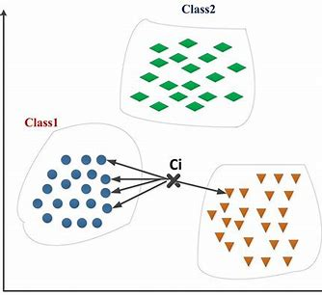
THE PROBLEM STATEMENT
The use of confidential data by companies is becoming increasingly prevalent, and accurate classification of this data is crucial for business decision-making. However, maintaining the confidentiality of such data is equally important.
The challenge is to develop a model that can classify confidential data while maintaining its security and privacy.

Slide 5
OBJECTIVE
The objective of this project is to apply the K-Nearest Neighbors (KNN) algorithm to classify confidential data provided by a company, while ensuring the data is not compromised.
The proposed project aims to create a secure classification system for confidential data in companies using the KNN-based classification technique. The primary goal of the project is to ensure the safety of confidential data while maintaining data privacy. The need for the project arises from the rising concerns regarding data privacy and security in various industries, especially in companies that deal with sensitive information. KNN is a widely used machine learning technique for data classification, and its application in secure data classification can greatly improve data privacy and security.

Slide 6
METHODOLOGY
The project will involve collecting and pre-processing confidential data, implementing the KNN algorithm, and evaluating the performance of the model. These techniques include privacy-preserving KNN classification, secure KNN computation, and KNN classification of encrypted data.
There are already projects that have tried to solve the problem of secure data classification. However, these designs have some disadvantages, such as B. limited scalability and low classification accuracy. Our proposed project aims to address these issues and provide a more efficient and accurate system for safely classifying data.
The implementation of the proposed KNN-based classification system can significantly benefit society by improving data privacy and security across different industries, especially for companies that handle sensitive information. The system can aid in preventing data breaches and protecting individuals' personal data, ultimately leading to increased trust and confidence in these companies.
The suggested system has the potential to enhance data privacy and security for businesses that handle sensitive information. By creating a KNN-based classification system that prioritizes data privacy and security, the risk of data breaches can be significantly reduced, safeguarding the personal information of individuals. Furthermore, the system's scalability and precision can enhance the effectiveness of data classification processes for these companies.

Slide 7

Working of the model has been described HERE:
Data Pre-processing: After collecting the data, we check the data and try to remove all the anomalies and fill the NULL values. In this model we also need to standardize the data
Splitting the Data: After the data preprocessing step, we need to split the data into Training and Test set data .
Finding K-Neighbors: In this we calculate KNN each data, Using euclidean distance formula.
Performance Evaluation: We will evaluate the performance of our model using various metrics like accuracy, precision, recall, and F1 score.

Slide 8
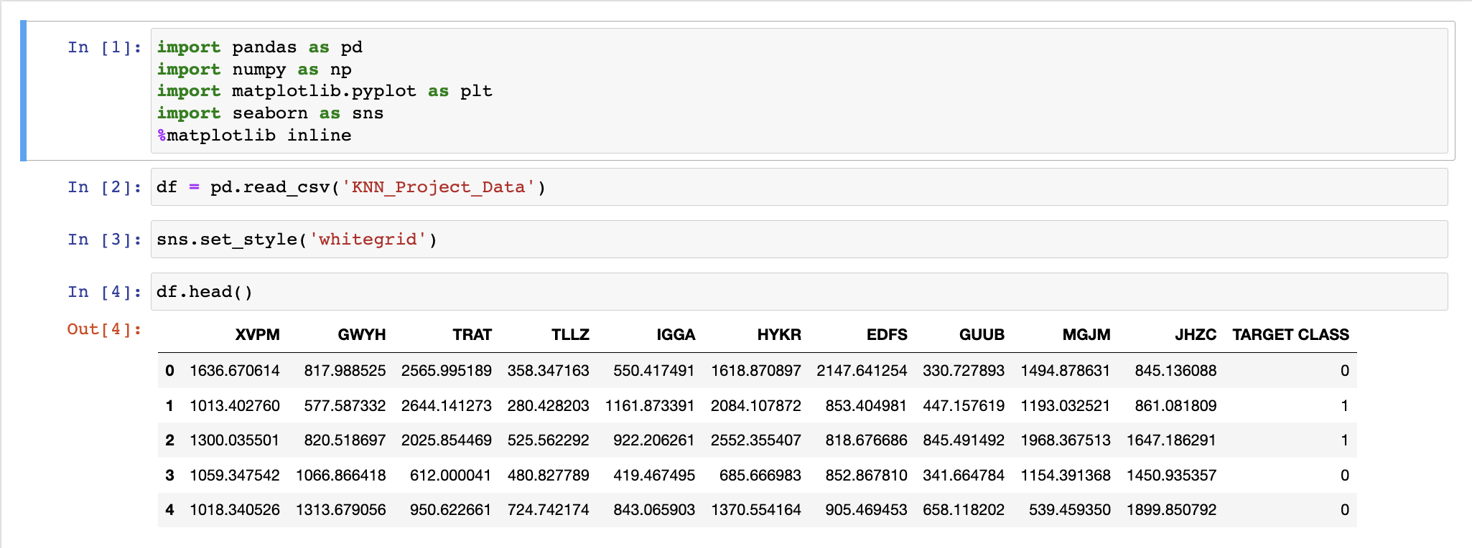
Implementation Details

Slide 9
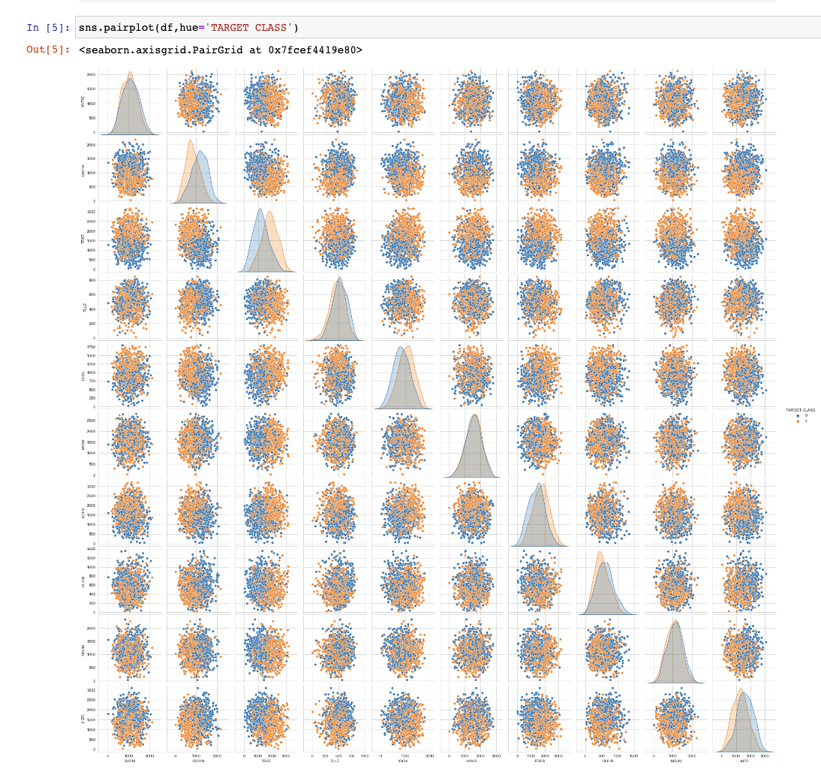
Data visualisation

Slide 10
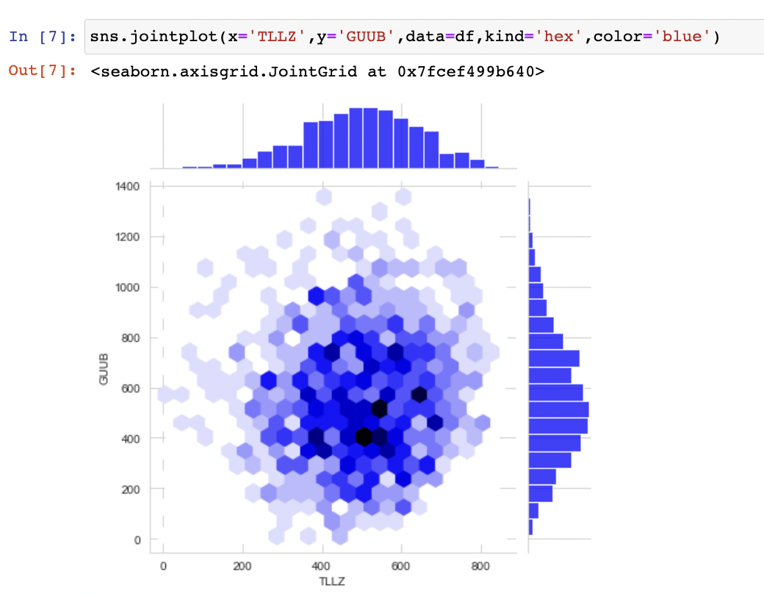
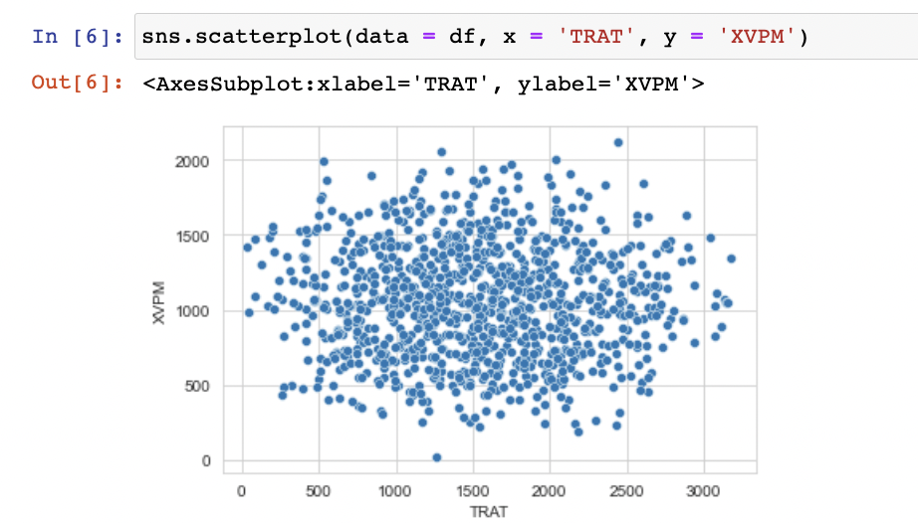

Slide 11
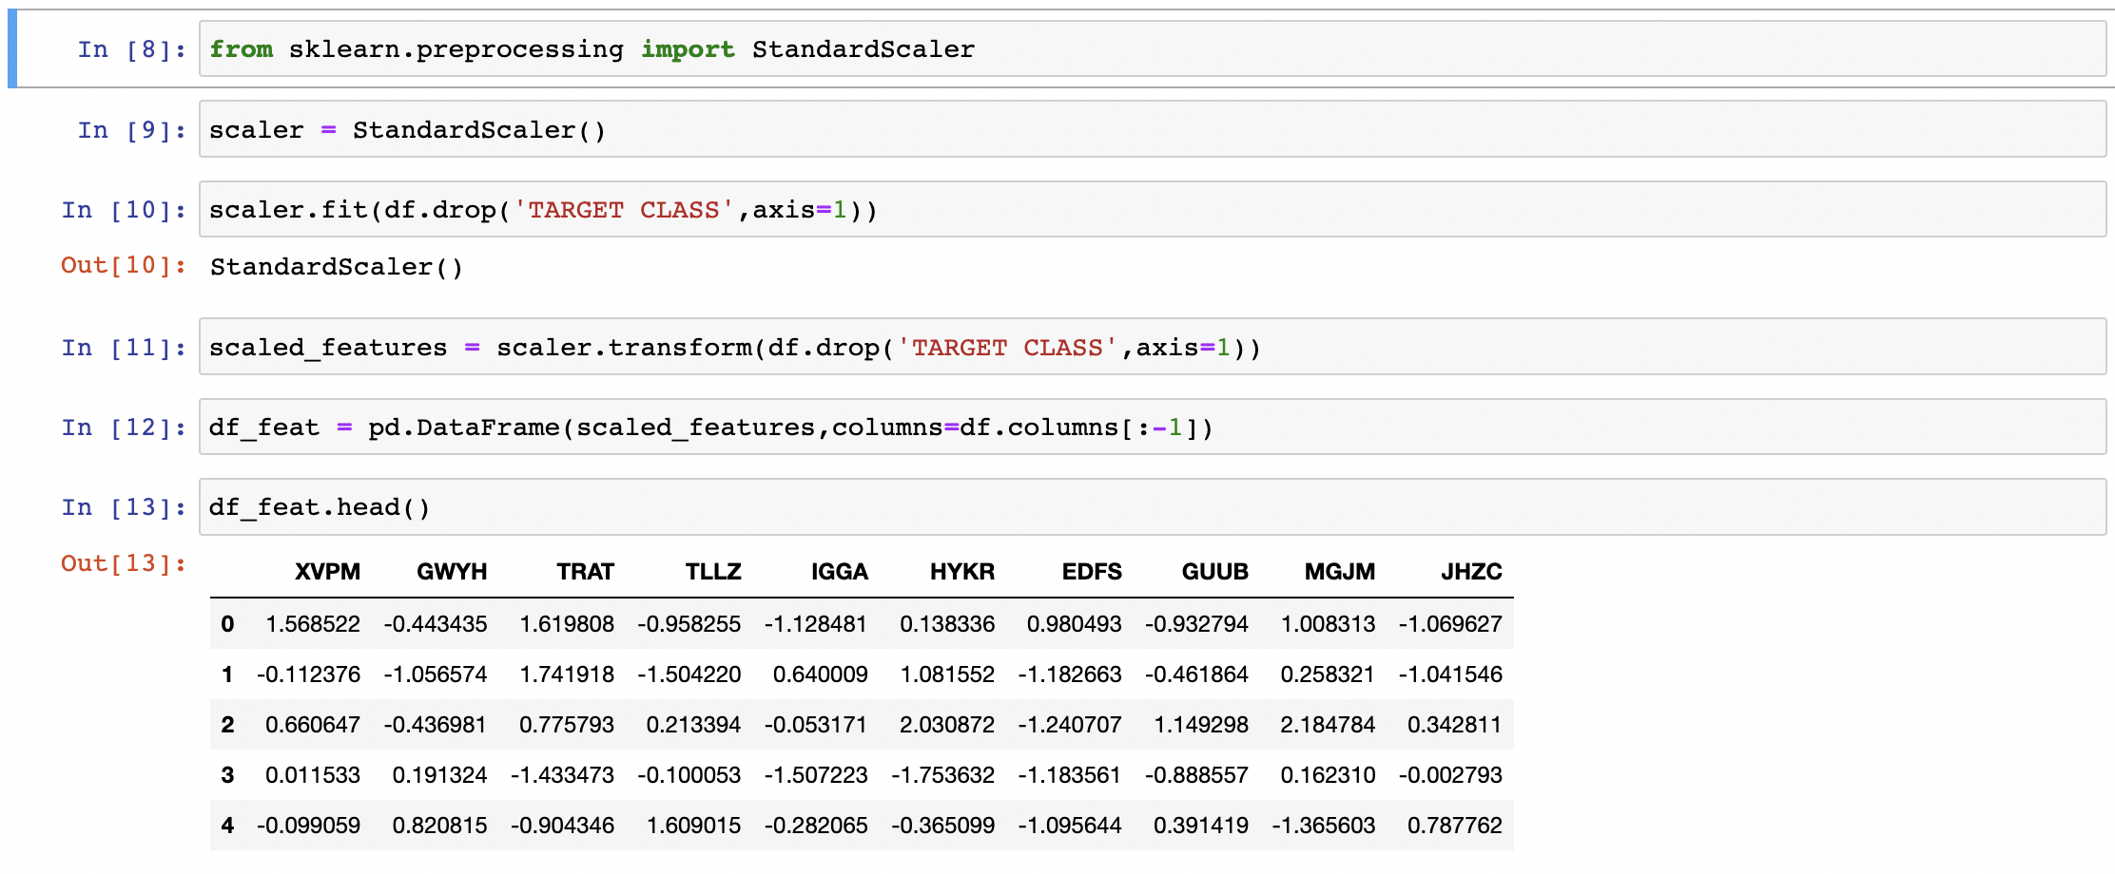
Data processing

Slide 12
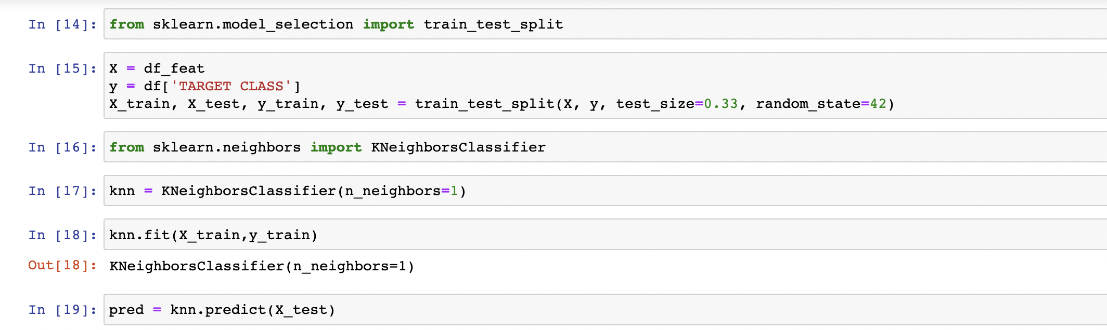
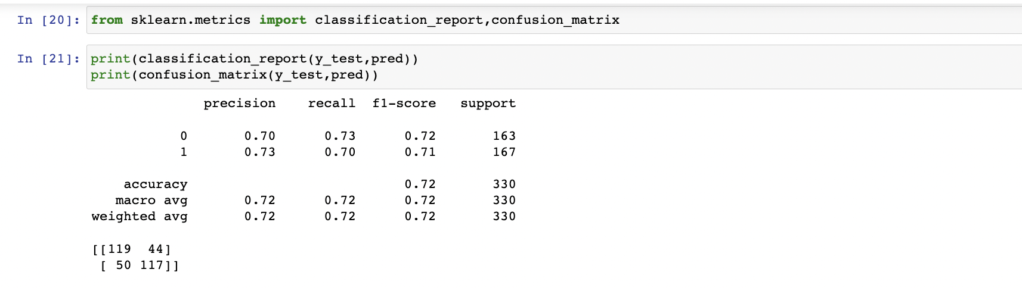
Model implementation

Slide 13
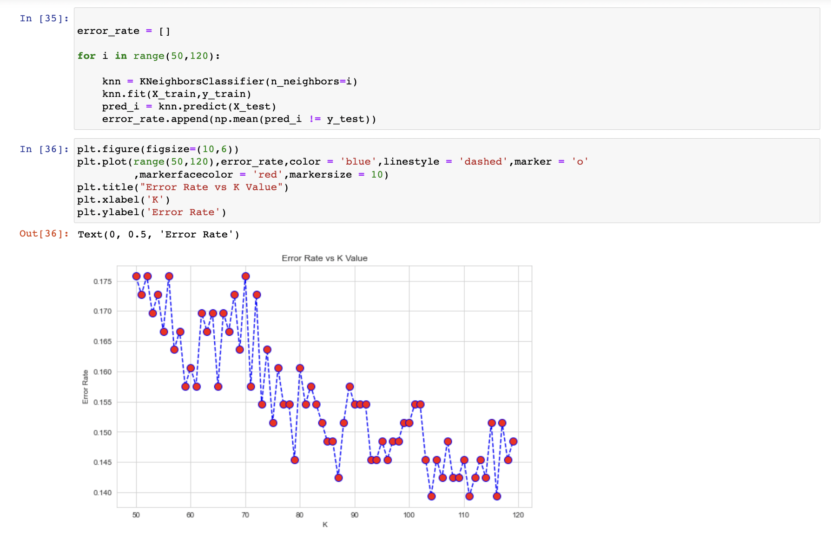
Increasing the model accuracy

Slide 14
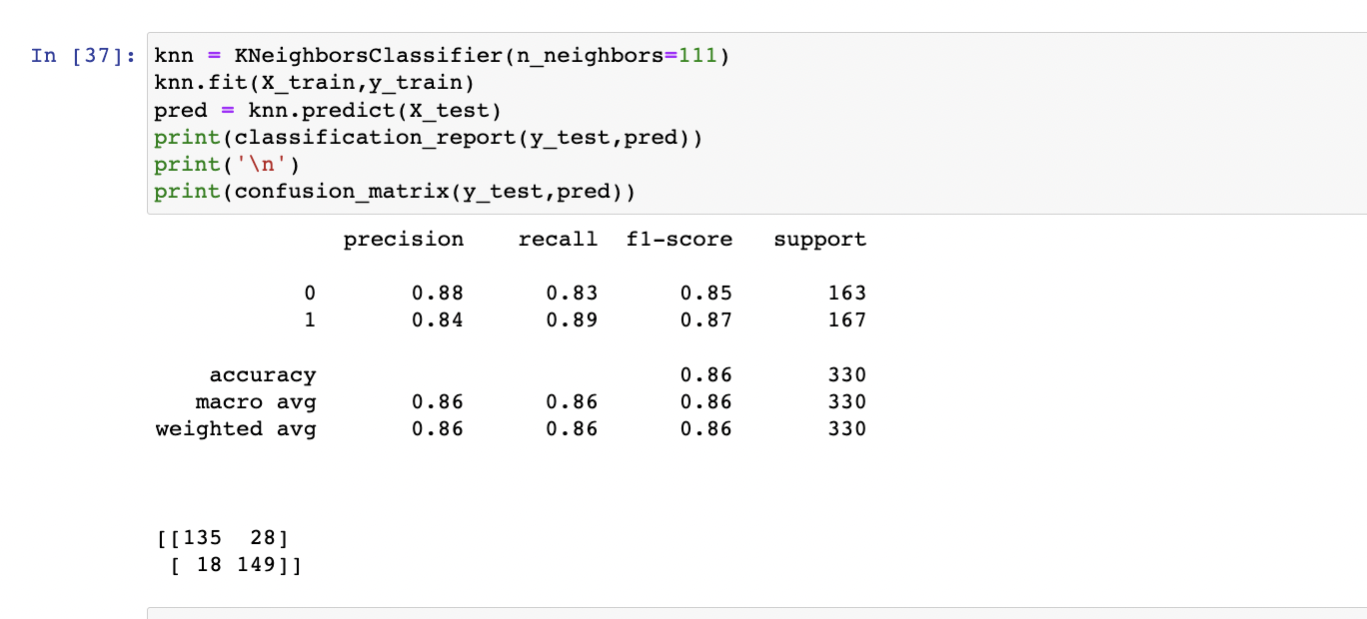
Improved result

Slide 15
Conclusion
K Nearest Neighbor (KNN) is a very simple, easy-to-understand, and versatile machine learning algorithm. It’s used in many different areas, such as handwriting detection, image recognition, and video recognition. KNN is most useful when labeled data is too expensive or impossible to obtain, and it can achieve high accuracy in a wide variety of prediction-type problems.
The downside to this simplicity is that it doesn’t make predictions for rare things (like new diseases), where KNN can’t predict because it has no idea what the prevalence of a rare thing would be in an otherwise healthy population.
Although KNN produces good accuracy on the testing set, the classifier remains slower and costlier in terms of time and memory. It requires large memory for storing the entire training dataset for prediction.

Slide 16
THANK you

